Slide 1
Functional Design
Lecturer: Ngo Huy Bien
Software Engineering Department
Faculty of Information Technology
VNUHCM - University of Science
Ho Chi Minh City, Vietnam
nhbien@fit.hcmus.edu.vn

Slide 2

Objectives
To design software systematically.

Slide 3

Contents
Functional Design Methodology.
Design and Programming Relationship.
Designing with Patterns.

Slide 4

References
Robert C. Martin (2017). Clean Architecture - A Craftsman's Guide to Software Structure and Design. Pearson Education.
David Budgen (2003). Software Design. Pearson.

Slide 5
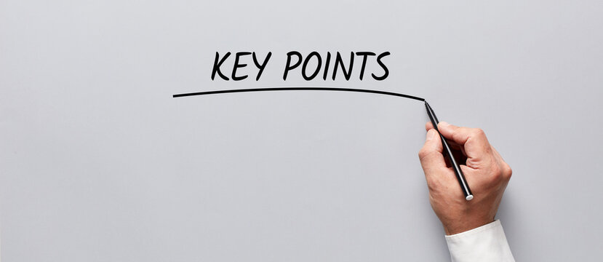
Key Ideas
Notations
Steps
Templates

Slide 6
Functional Programming [1]
(println (take 25 (map (fn [x] (* x x)) (range))))
Variables in functional languages do not vary.

Slide 7
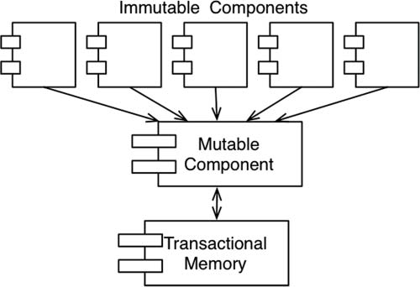
FP & Design
All race conditions, deadlock conditions, and concurrent update problems are due to mutable variables.
All the problems that we face in concurrent applications—all the problems we face in applications that require multiple threads, and multiple processors—cannot happen if there are no mutable variables.
The point is that well-structured applications will be segregated into those components that do not mutate variables and those that do.

Slide 8
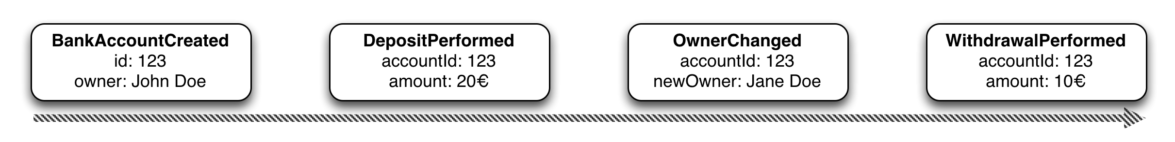
Event Sourcing
The question you must be asking yourself, then, is whether immutability is practicable.
The answer to that question is affirmative, if you have infinite storage and infinite processor speed.
Event sourcing is a strategy wherein we store the transactions, but not the state.
When state is required, we simply apply all the transactions from the beginning of time.

Slide 9
Review
Structured programming imposes discipline on direct transfer of control.
Object-oriented programming imposes discipline on indirect transfer of control.
Functional programming imposes discipline upon assignment.
Each of these three paradigms has taken something away from us. What we have learned over the last half-century is what not to do.
Software—the stuff of computer programs—is composed of sequence, selection, iteration, and indirection. Nothing more. Nothing less.

Slide 10
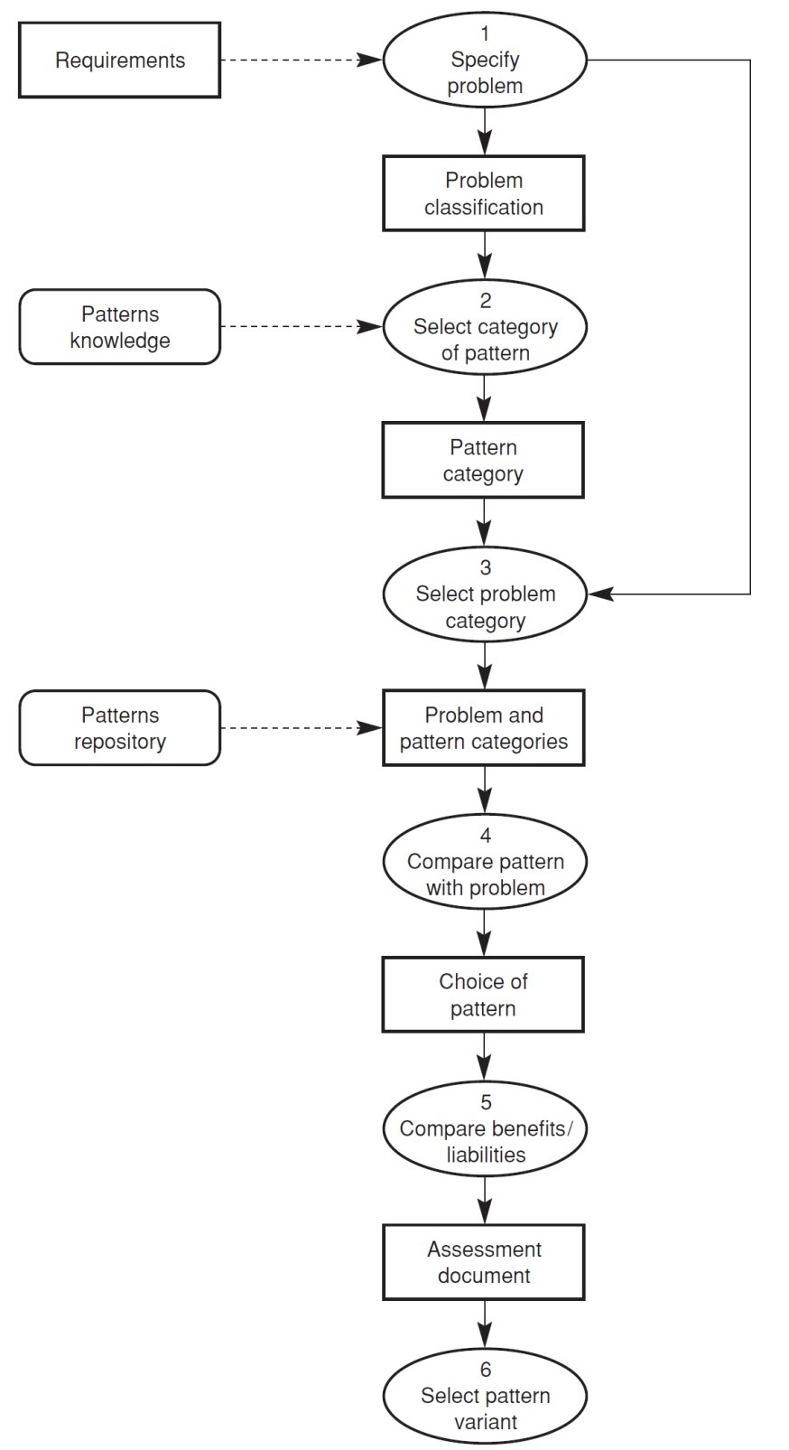
Designing with Patterns [2]

Slide 11

Thank You & See You Again

